Slide 1
Segmentation
Fareeza Khurshed
Alberta Blue Cross
Data for Good, YEG

Slide 2
Agenda
High level overview of segmentation
Methods available for segmentation
Use Case Example
Can follow along via – github link
References for more details
Questions

Slide 3
What is Segmentation?
Dictionary definition
Segmentation
Act of dividing into segments
Segment
One of the constituent parts into which a body, entity, or quantity is divided or marked off by or as if by natural boundaries

Slide 4

Segments Environics PRIZM

Slide 5
Segmentation
Customer Segmentation
Split customers into groups of who are more <profitable> versus less <profitable>
Market Segmentation
Separates potential customers into broad groups to more accurately target them
Environics PRIZM

Slide 6
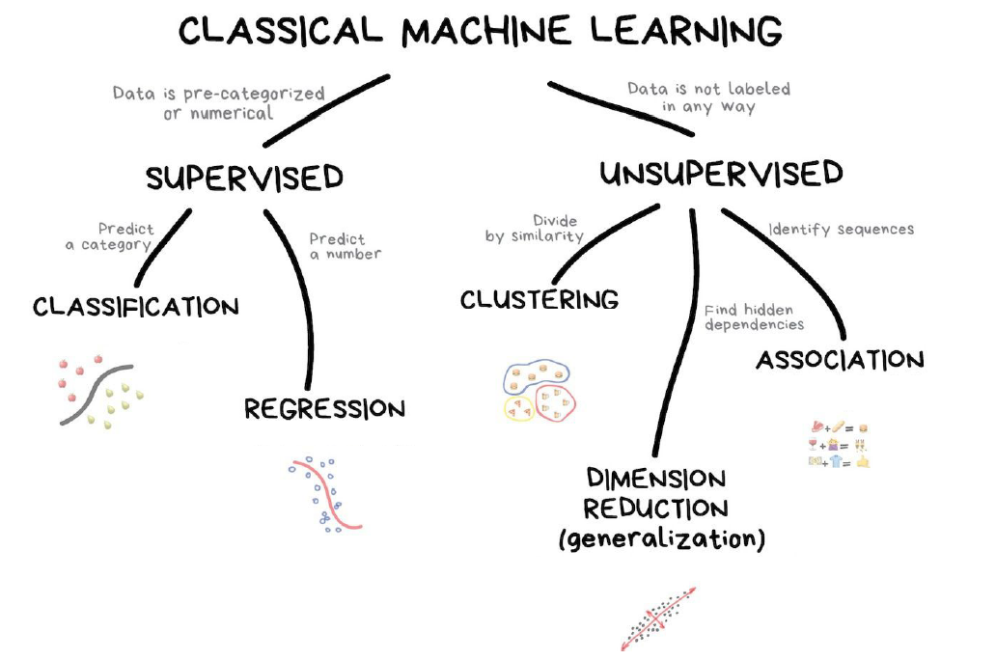
Segmentation

Slide 7
Three components
Variables
Distance Measure
“Slicing” methodology

Slide 8
Which measures?
Demographic
Psychographic
Behavioral
Geographic

Slide 9
Segmentation - Variables
Demographic
Age
Sex
Marital Status
Income
Psychographics
Activities
Values
Attitudes
Behavioural
Patterns
Usage rates
Benefits
Geographical
Local
National
Urban/Rural
Postal codes
RFM

Slide 10
Segmentation variable selection depends on the problem of interest

Slide 11
Examples of variables
Market Segmentation
Prior to becoming a customer – limited data available
Aggregate data
Census data by geographies
Demographic + Geographic
Customer profiles/data from website or a third-party site
Customer Segmentation
Individual level data
Demographic data
Location data (based on address/postal code) to infer other demographic traits
Outcome of interest
Profitability
Purchases
Tenure

Slide 12
Variables – data preparation
Standardize variables
Parameterize categorical variables such as Sex, Gender, Geography
Different parameterization methods are available (out of scope)
Ensure no missing values in data

Slide 13
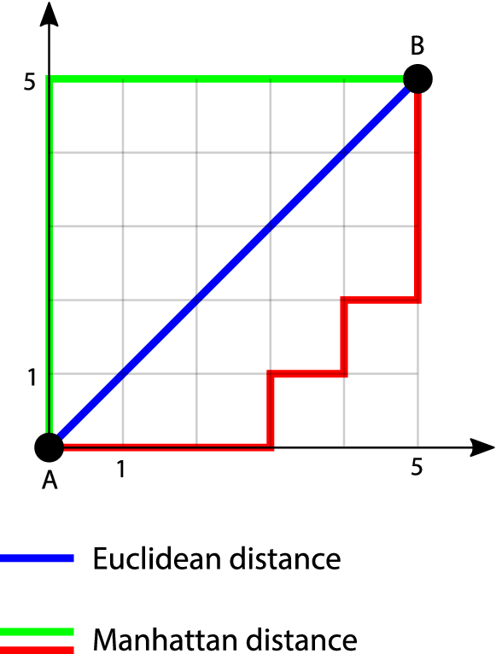
What is similarity?
From a continuous data perspective:
Distance between features
Multiple ways to measure distance!!
What happens if the X axis was in KM and the Y axis was in Miles?
Standardize!

Slide 14
Slicing Methodology
K-Means
Hierarchical Clustering
Optimal # of clusters

Slide 15
K-Means
K-means clustering is an example of an unsupervised learning algorithm and it works as follows:
Choose a number of clusters, K (this is what the k stands for in k-means clustering), into which the data are to be divided
Assign arbitrarily K number of cluster centres
Assign data points to cluster centre which is nearest to them, most commonly using the Euclidean distance formula
Once all the data points have been clustered according to their cluster centres, calculate the centroid of each cluster, using the mean values of the data points assigned to that cluster
Reset cluster centres using those centroids
Repeat steps 3 to 5 until no re-assignment of cluster centres take place i.e. until the algorithm has fully converged
Source: https://medium.com/swlh/customer-segmentation-using-k-means-clustering-in-r-a74d512a4cfa

Slide 16
K-Means

Slide 17
Hierarchical Clustering
Hierarchical clustering starts by treating each observation as a separate cluster.
Identify the two clusters that are the closest together
Merge the most two similar clusters
Repeat until all clusters are merged together.

Slide 18
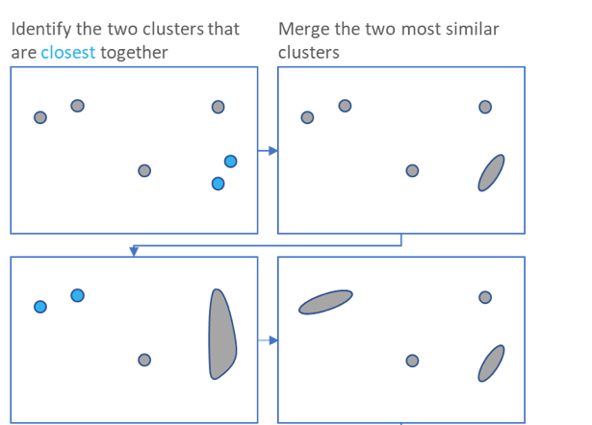
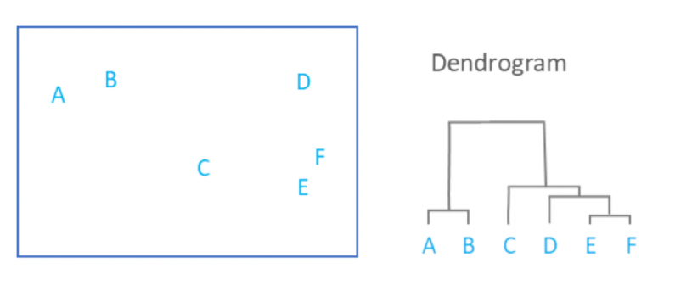

Slide 19
Optimal # of clusters
Silhouette score
Elbow method

Slide 20
Silhouette Score
Measure of how close each point in one cluster is to points in the neighbouring clusters and thus provides a way to assess parameters visually
Score ranges between -1 and 1
Close to 1 : Cluster is dense, well separated
Close to 0 : Overlapping clusters
Close to -1 : Samples may have been assigned to the wrong cluster
Look for size of groups (width of plots)
Look for above average score

Slide 21
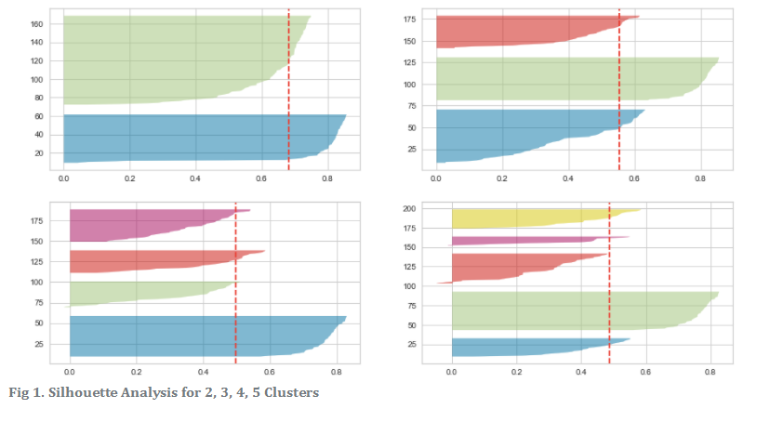
Silhouette Score
Notes:
Here is the Silhouette analysis done on the above plots to select an optimal value for n_clusters.
The value of n_clusters as 4 and 5 looks to be suboptimal for the given data due to the following reasons:
Presence of clusters with below-average silhouette scores
Wide fluctuations in the size of the silhouette plots.
The value of 2 and 3 for n_clusters looks to be the optimal one. The silhouette score for each cluster is above average silhouette scores. Also, the fluctuation in size is similar. The thickness of the silhouette plot representing each cluster also is a deciding point. For the plot with n_cluster 3 (top right), the thickness is more uniform than the plot with n_cluster as 2 (top left) with one cluster thickness much more than the other. Thus, one can select the optimal number of clusters as 3.
Source: https://dzone.com/articles/kmeans-silhouette-score-explained-with-python-exam#:~:text=Silhouette%20score%20is%20used%20to,are%20similar%20to%20each%20other.&text=denoted%20by%20a-,Mean%20distance%20between%20the%20observation%20and%20all%20other,of%20the%20next%20nearest%20cluster.

Slide 22
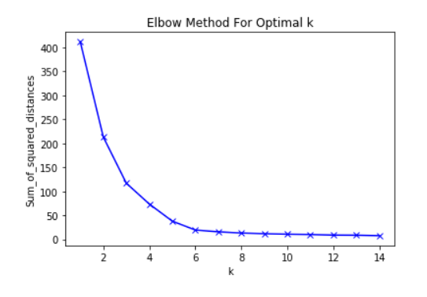
Elbow method
Sum of squared distances between samples to the nearest cluster center
As k increases, the sum of squared distance tends to zero. Imagine we set k to its maximum value n (where n is number of samples) each sample will form its own cluster meaning sum of squared distances equals zero.
Where does the curve flatten?
K=5

Slide 23
What is segmentation?
If we change the features/variables, the segments change
If we change the activity/outcome, the segments change
If we change the analysis technique, the segments change
Not a “one time” activity

Slide 24
Use Case Example
Market Segment Analysis
Aggregate data

